Slide 1
Module – 1 Big Data Technology Landscape
Dr. S. NANDAGOPALAN

Slide 2
Syllabus : 1501413 Big Data Management and Analytics
Module 1: Big Data Technology Landscape:
Introduction to Big Data Analytics, Evolution of Big Data Technology, Scalability and Parallel processing, Designing Data Architecture,
Tools and Technologies for Big Data Analytics-Apache Hadoop, Apache Spark, PySpark, Scala, Apache Kafka, NoSQL, Distributed SQL Query Engine, etc., Applications of Big Data Analytics (Healthcare, Finance, Social Media, IoT, etc.)

Slide 3
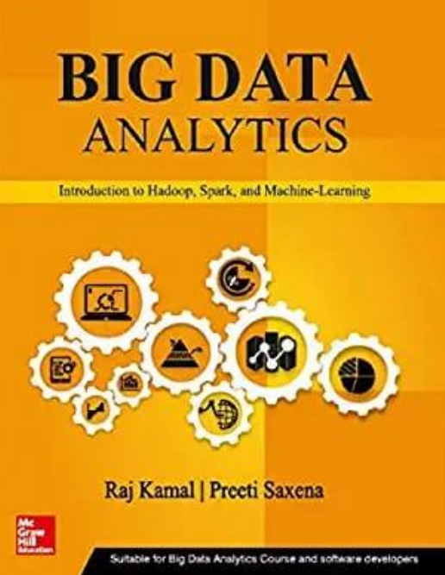
Text Book for M1

Slide 4
Agenda
What is Big Data?
Overview
Business Intelligence Concepts and Applications
Data Warehousing
Data Mining
Data Visualization
Summary

Slide 5
Big Data

Slide 6
What is Big Data?
Collection of datasets so large and complex that it becomes difficult to process using on-hand database management tools.
Challenges include capture, curation, storage, search, sharing, analysis, and visualization
Additional information is derivable from analysis of a single large set of related data, as compared to separate smaller sets
to spot business trends, determine quality of research, prevent diseases, link legal citations, combat crime, and determine real-time roadway traffic conditions

Slide 7
What is Big Data? (Contd.)
Volume: Large volumes clearly define Big Data. In some cases, the sheer size of the data makes it impossible to evaluate by more conventional means.
Variety: Data may come from a variety of sources and not necessarily be "related" to other data sources.
Velocity: The term velocity in this context refers to how fast the data can be generated and processed.
Variability: Data may be highly variable, incomplete, and inconsistent.
Complexity: Relationships between data sources may not be entirely clear and not amenable to traditional relational methods.

Slide 8
Business Issues
How to use generated data as a strategic asset in real-time, to identify opportunities, thwart threats and achieve operational efficiencies?
How to organize the business to not get buried in high volume, velocity and variety of data?
How to design a ‘Digital Business Strategy’ around digital assets and capabilities?
Analytics of Big Data could enable discovery of new facts, knowledge and strategy in a number of fields, such as manufacturing, business, finance, healthcare, medicine and education.
Evolving strategy to defeat an opponent could even make good use of the data in games – Tennis, Cricket, Football, etc.

Slide 9

Growth of Big Data

Slide 10
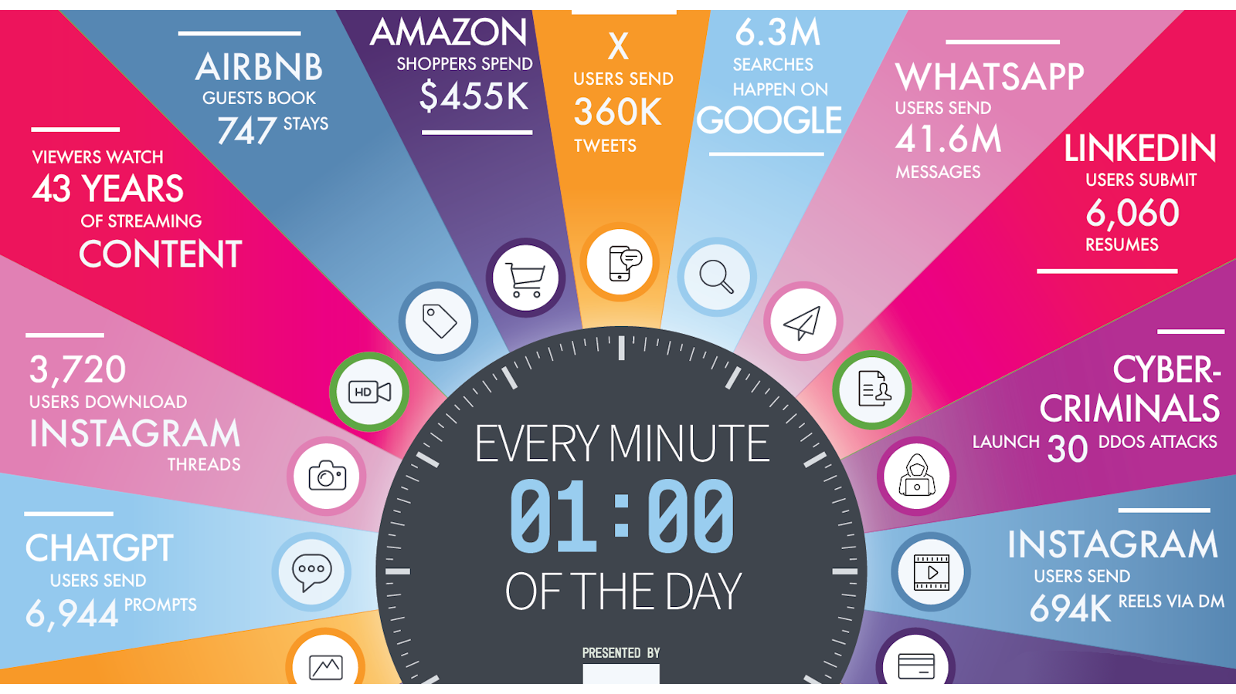

Slide 11
BI Cycle
Business generates data. Data is Mined to produce Insights & Intelligence
Intelligence is fed back into business. Business performance improves; more data …
Business
Intelligence
Data
Mining

Slide 12
Key Terms
API
Data Model-Schema
Data Repository
Data Store
Database & DBMS
Table
Flat file
SQL
ODBC & JDBC
DWH & Data Mart
Batch Processing
Streaming & real time
ETL
Predictive Analytics
Cognitive Analytics

Slide 13
Classification of Data-Structured, Semi-structured and Unstructured
Structured: Tables – rows & columns – follows schema
Semi structured: contain tags or other markers – HTML, JSON
Unstructured: do not conform and associate with any data models.
E.g. Text messages, chat messages, tweets (X), YouTube
Multi-Structured: data consisting of multiple formats of data, viz. structured, semi-structured and/or unstructured data.
E.g. Streaming data, Sensor data, Excel, POS, etc.

Slide 14
Big Data Types
Social networks and web data: Facebook, Twitter (X), e-mails
Transactions data and Business Processes (BPs) data - credit card transactions, flight bookings.
Customer master data, such as data for facial recognition and for the name, date of birth, marriage anniversary, gender, location and income category
Machine-generated data - data from sensors, trackers, web logs.
Human-generated data - biometrics data, human-machine interaction data, e­-mail records.

Slide 15
Example
Chocolate Marketing Company (ACVM) with Vending Machines
It sells five flavours (FLl, FL2, FL3, FL4 and FL5) KitKat, Milk, Fruit and Nuts, Nougat, and Oreo.
Machine-generated data: sale of chocolates.
Human-generated data: buyer-machine interactions.
Social networks and web data: feedback and personalized messages based on interactions.
Human-generated data: facial recognition of the buyers.
Goal: Sales Analysis

Slide 16
Big Data Classification

Slide 17
Scalability and Parallel Processing
Scalability enables increase or decrease in the capacity of data storage, processing and analytics.
Scalability is the capability of a system to handle the workload as per the magnitude of the work.
Vertical scalability: scaling up the given system's resources and increasing the system's analytics, reporting and visualization capabilities.
Horizontal scalability: means increasing the number of systems working in coherence and scaling out the workload.

Slide 18
Massively Parallel Processing Platforms
Single computer system is not suitable for big data.
Scaling uses parallel processing systems.
Parallelization of tasks:
distributing separate tasks onto separate threads on the same CPU.
distributing separate tasks onto separate CPUs on the same computer.
distributing separate tasks onto separate computers.

Slide 19
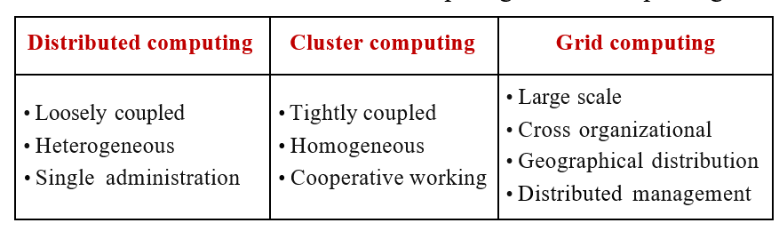
Grid and Cluster Computing
Grid Computing: a group of computers from several locations are connected with each other to achieve a common task.
Cluster Computing: A cluster is a group of computers connected by a network. The group works together to accomplish the same task (Hadoop, Spark.)

Slide 20
Designing Data Architecture
Architecture logically defines how Big Data solution will work, the core components (hardware, database, software, storage) used, flow of information, security and more.

Slide 21
Data Sources, Quality, Pre-processing and Storing
Data Sources: sensors, trackers, web logs, computer systems logs and feeds (structured or Semi-Structured or Unstructured)
Structured Data Sources
SQL Server, MySQL, Microsoft Access database, Oracle DBMS, IBM DB2, Informix, Amazon SimpleDB
Unstructured Data Sources
Unstructured data sources are distributed over high-speed networks.
The data need high velocity processing.
Sources are from distributed file systems.
The sources are of file types, such as .txt (text file), .csv (comma separated values file).

Slide 22
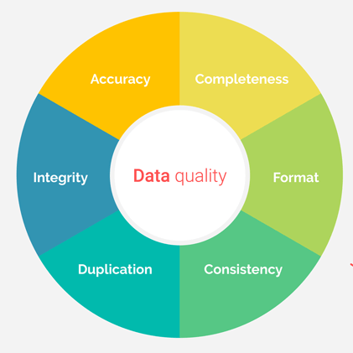
Data Quality
Data quality is assessed based on factors such as:
Accuracy, Completeness, Consistency, Validity, Uniqueness, Timeliness, and Relevance.
Why important?
Data-driven decisions
Compliance
Risk management
Data Noise, Outliers, Missing and Duplicate Values

Slide 23
Data Pre-processing
To clean the data – “Garbage in Garbage out”
Pre-processing needs are:
Dropping out of range, inconsistent and outlier values
Filtering unreliable, irrelevant and redundant information
Data cleaning, editing, reduction and/or wrangling
Data validation, transformation or transcoding
ELT processing

Slide 24
Data Storage And Analysis
What are the sources of structured data store?
Business process data which stores business events, such as registering a customer, taking an order, generating an invoice, and managing products in pre-defined formats.
The data falls in the category of highly structured data.
The data consists of transaction records, tables, relationships and metadata that build the information about the business data.
Commercial transactions Banking/ stock records.
E-commerce transactions data.

Slide 25
Data Storage And Analysis
What are the sources of semi-structured data store?
XML and JSON semi-structured documents.
CSV files
SQL
Large Data Storage using RDBMS
DDBMS - a collection of logically interrelated databases at multiple system over a computer network
In-Memory Column Formats Data: Data in a column are kept together in-memory in columnar format
analysis of monthly sales of chocolates on ACVMs
DWH

Slide 26
Big Data Storage
NoSQL Databases
When you first hear “NoSQL,” an immediate question is what does it stand for—a “no” to SQL?
Most people who talk about NoSQL say that it really means “Not Only SQL,” but this interpretation has a couple of problems
polyglot persistence - Polyglot Persistence means that when storing data, it is best to use multiple data storage technologies, chosen based upon the way data is being used by individual applications or components of a single application.

Slide 27
Characteristics of NoSQL databases
Not using the relational model
Running well on clusters
Open-source
Built for the 21st century web estates
Schemaless
Flexibility
Scalability
Horizontal scaling
Fast queries due to the data model
Ease of use for developers

Slide 28
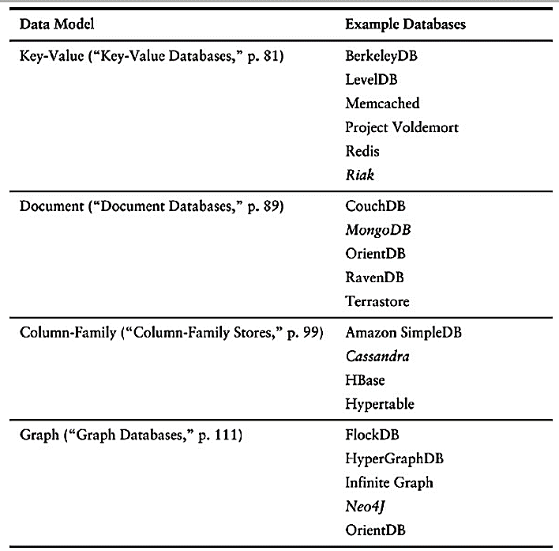
NoSQL Databases
Amazon DynamoDB : Key-Value and Document Database

Slide 29
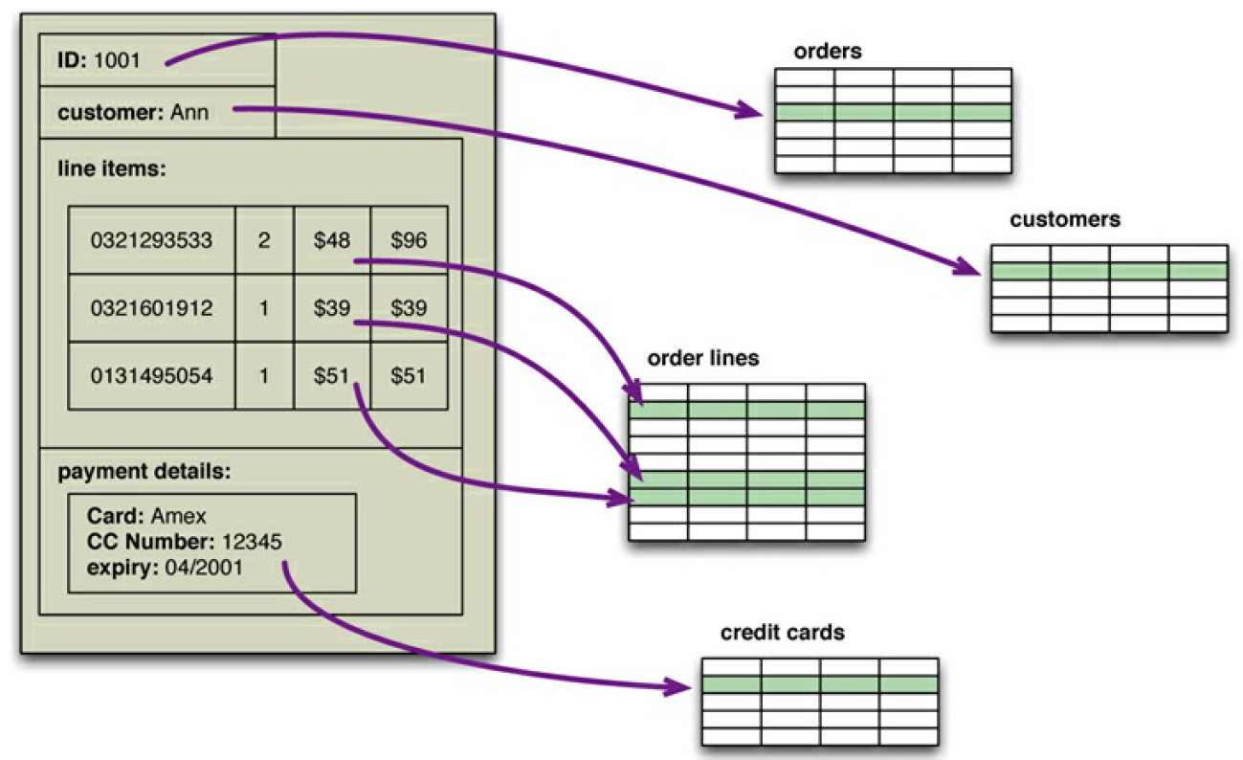
NoSQL vs. Tables
An order, which looks like a single aggregate structure in the UI, is split into many rows from many tables in a relational database

Slide 30
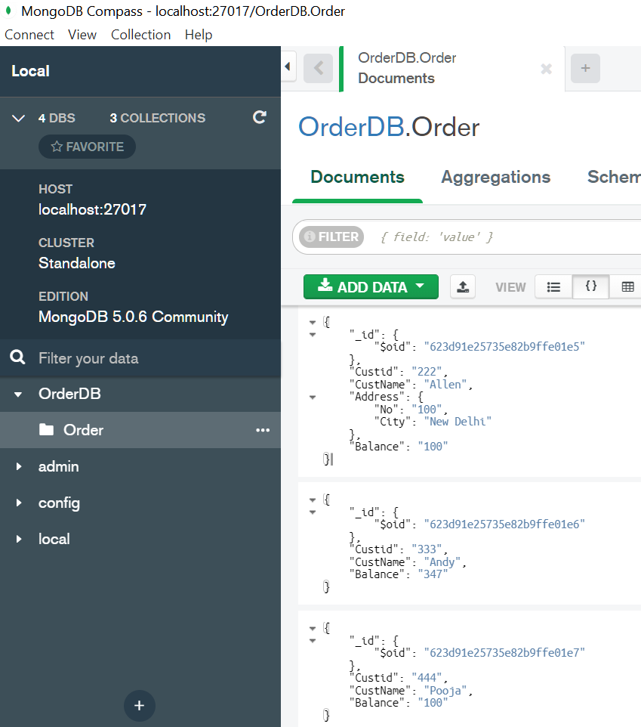
MongoDB
NoSQL databases are generally based on the needs of the early 21st century web estates
NoSQL databases operate without a schema

Slide 31
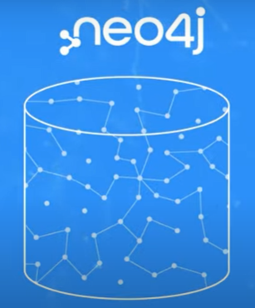
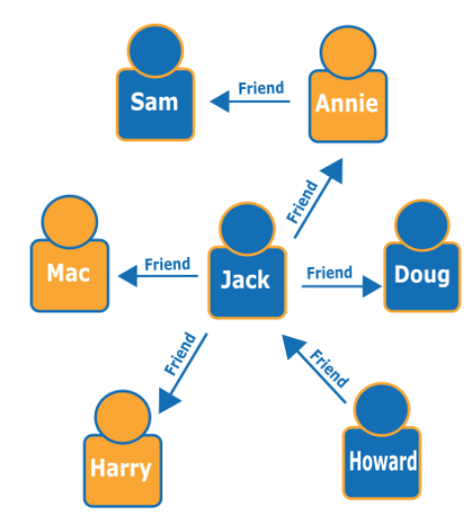
Graph Databases
Graph databases are to store and navigate relationships.
Graph databases use nodes to store data entities, and edges to store relationships between entities.
An edge always has a start node, end node, type, and direction, and an edge can describe parent-child relationships, actions, ownership, and the like.
There is no limit to the number and kind of relationships a node can have.

Slide 32
Big Data Platform
Tools & Services:
Storage, processing and analytics
Developing, deploying, operating and managing Big Data environment
Reducing the complexity of multiple data sources and integration of applications into one cohesive solution
Custom development, querying and integration with other systems
The traditional as well as Big Data techniques.

Slide 33
Services Required
New innovative non-traditional methods of storage, processing and analytics
Distributed Data Stores
Creating scalable as well as elastic virtualized platform (cloud computing)
Huge volume of Data Stores
Massive parallelism
High speed networks
High performance processing, optimization and tuning
Data management model based on Not Only SQL or NoSQL
In-memory data columns as well as row formats for OLAP and OLTP
Data retrieval, mining, reporting, visualization and analytics
Graph databases
Machine learning or other approaches
Big data sources: Data storages, DWH, Oracle Big Data, MongoDB, Cassandra
Data sources: Sensors, Audit trail of Financial transactions data, external data such as Web, Social Media, weather data, health records data.

Slide 34
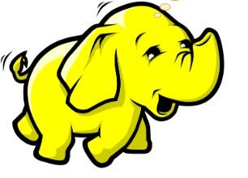
Hadoop
History:
Hadoop is an open-source software framework for storing and processing large datasets - gigabytes to petabytes.
Hadoop was developed at the Apache Software Foundation.
In 2008, Hadoop defeated the supercomputers and became the fastest system on the planet for sorting terabytes of data.
In November 2008, Google reported that its Mapreduce implementation sorted 1 terabyte in 68 seconds.
In April 2009, a team at Yahoo used Hadoop to sort 1 terabyte in 62 seconds, beaten Google MapReduce implementation.

Slide 35
Hadoop’s HDFS
The Hadoop Distributed File System (HDFS) was designed for Big Data processing.
HDFS is not designed as a true parallel file system.
Design assumes a large file write-once/read-many model that enables other optimizations and relaxes many of the concurrency and coherence overhead requirements of a true parallel file system HDFS rigorously restricts data writing to one user at a time.
All additional writes are "append-only," no random writing to HDFS files.
Bytes are always appended to the end of a stream, and byte streams are guaranteed to be stored in the order written.
The design of HDFS is based on the design of the Google File System (GFS).
HDFS is designed for data streaming.
The HDFS block size is typically 64MB or 128MB.

Slide 36
HDFS Commands
1. Create a directory called user:
c:\hadoop\sbin>hdfs dfs -mkdir /user
2. Copy the file Hello.java from local drive to /user and display the file:
c:\hadoop\sbin>hdfs dfs -copyFromLocal D:\Hello.java /user
c:\hadoop\sbin>hdfs dfs -cat /user/Hello.java
/* First Java program to say Hello */
public class Hello { // Save as "Hello.java" under "d:\myProject"
public static void main(String[] args) {
System.out.println("Hello, world!");
}
}
3. List Files in /user directory
c:\hadoop\sbin>hdfs dfs -ls /user
Found 1 items
-rw-r--r-- 1 Admin supergroup 210 2024-08-10 10:47 /user/Hello.java

Slide 37
Hadoop MapReduce Framework
Software framework- multi-terabyte data-sets of data in-parallel on large clusters.
A MapReduce job usually splits the input data-set into independent chunks which are processed by the map tasks in a completely parallel manner.
The framework sorts the outputs of the maps, which are then input to the reduce tasks.
Simple Example:
Assume that you want to count the frequency of occurrence of the word “data” in the book “Big Data Analytics”.
Call 20 friends and give each chapter in the book to search- “MAP” task.
After all 20 completed counting, simply sum it - “Reduce” task.

Slide 38
Big Data Analytics Applications
Big Data in Marketing and Sales
Marketing - is the creation, communication and delivery of value to customers.
Customer (desired) value - what a customer desires from a product?
Customer (perceived) value - what the customer believes to have received from a product after purchase of the product.
Customer value analytics (CVA) - analyzing what a customer really needs.
Big Data use cases:
CVA using the inputs of evaluated purchase patterns, preferences, quality, price and post sales servicing requirements
Operational analytics for optimizing company operations
Detection of frauds and compliances
New products and innovations in service
Enterprise data warehouse optimization.

Slide 39
Big Data Analytics in Detection of Marketing Fraud
Fusing of existing data at an enterprise data warehouse with data from sources such as social media, websites, e-mails, and thus enriching existing data
Using multiple sources of data and connecting with many applications
Providing greater insights using querying of the multiple source data
Analyzing data which enable structured reports and visualization
Providing high volume data mining, new innovative applications and thus leading to new business intelligence and knowledge discovery

Slide 40
Big Data and Healthcare
Data sources:
Clinical records, pharmacy records, electronic medical records diagnosis logs and notes and additional data, such as deviations from person usual activities, medical leaves from job, social interactions.
Analytics:
Provisioning of value-based and customer-centric healthcare,
Utilizing the 'Internet of Things' for health care
Preventing fraud, waste, abuse in the healthcare industry and reduce healthcare costs (Example: frauds are excessive or duplicate claims for clinical and hospital treatments. Example: waste is unnecessary tests. Abuse means unnecessary use of medicines, such as tonics and testing facilities.)
Improving outcomes
Monitoring patients in real time.

Slide 41
Big Data in Medicine
Building the health profiles of individual patients and predicting models for diagnosing better and offer better treatment.
Aggregating large volume and variety of information around from multiple sources the DNAs, proteins, and metabolites to cells, tissues, organs.
Deploying wearable devices data.

Slide 42
Big Data in Advertising
The digital advertising industry sends advertisements using SMS, e-mails, YouTube, WhatsApp, Linkedln, Facebook, Twitter (X), and other mediums.
Big Data technology and analytics provide insights, patterns and models.
Advertisement of the introduction of new courses by an institution.
Introduction of new flights by an Airline needs media other than TV and requires targeted and cost effective solutions.

Slide 43
Apache Spark
Spark is an in-memory cluster computing framework for processing and analyzing large amounts of data.
Spark is faster than Hadoop MapReduce.
Spark provides a unified integrated platform for different types of data processing jobs.
Spark is scalable.
Spark is fault tolerant.

Slide 44
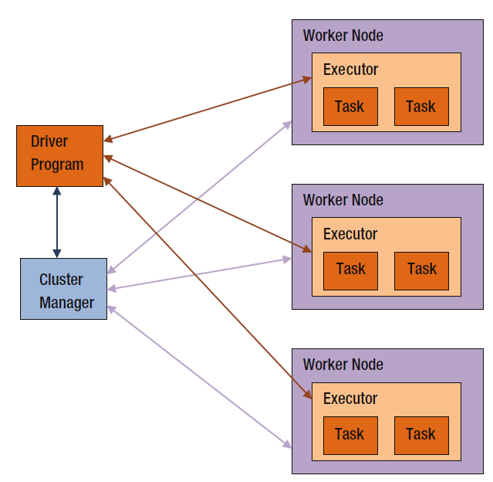
Spark Architecture
A worker provides CPU, memory, and storage resources to a Spark application.
A cluster manager to acquire cluster resources for executing a job.

Slide 45
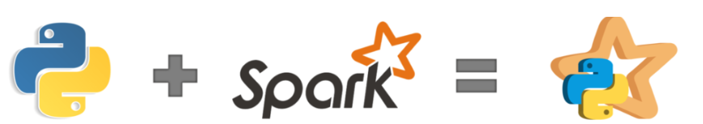
PySpark
PySpark is a powerful open-source framework built on Apache Spark.
Designed to simplify and accelerate large-scale data processing and analytics tasks.
Offers a high-level API for Python programming language, enabling seamless integration with existing Python ecosystems.
PySpark is very well used in the Data Science and Machine Learning community.

Slide 46
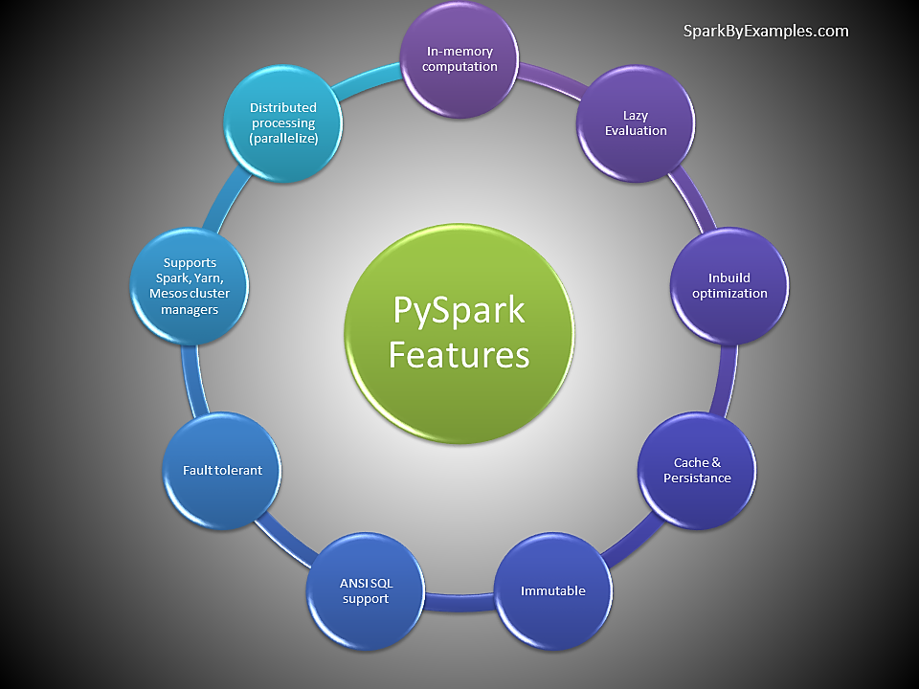
Features of PySpark

Slide 47
Example
# Basic PySpark Example - Extract from .csv and transform
from pyspark.sql import SparkSession
# Create a SparkSession
spark = SparkSession.builder.appName("BasicPySparkExample").getOrCreate()
# Read data from a CSV file
df = spark.read.csv("E:/PySparkProjects/data/input.csv", header=True, inferSchema=True)
# Select specific columns
filtered_df = df.select("Surname", "Email")
# Show the results
filtered_df.show()
# Stop the SparkSession
spark.stop()

Slide 48
Apache Kafka – an Introduction
Kafka combines three key capabilities:
To publish (write) and subscribe to (read) streams of events, including continuous import/export of your data from other systems.
To store streams of events durably and reliably for as long as you want.
To process streams of events as they occur or retrospectively.

Slide 49
Contd…
Producers are those client applications that publish (write) events to Kafka.
Consumers are those that subscribe to (read and process) these events.
In Kafka, producers and consumers are fully decoupled.
For example, producers never need to wait for consumers.
Events are organized and durably stored in topics.
Topic is similar to a folder in a filesystem, and the events are the files in that folder.
E.g. Uber’s dynamic pricing.

Slide 50
Thank You

